Slide 1
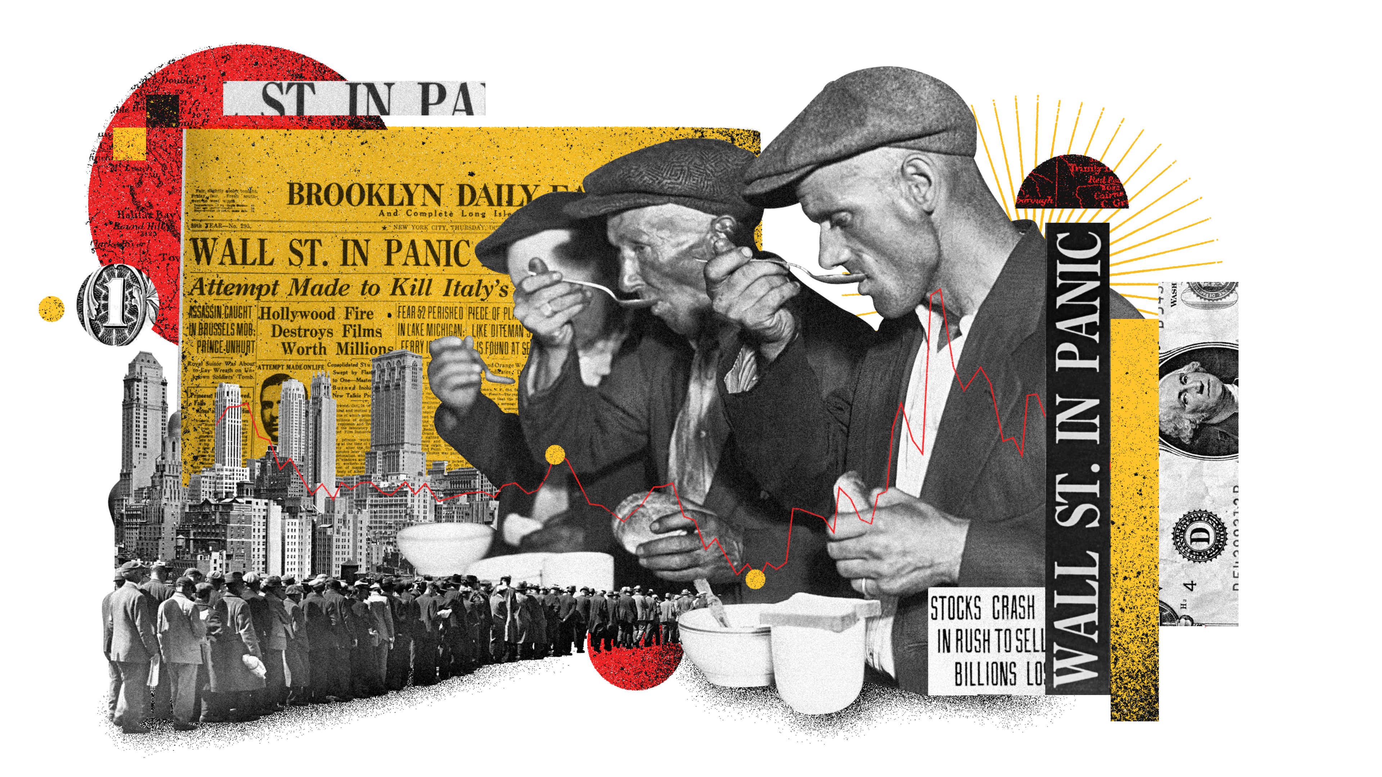
The Great Depression
Its Effect on Literature and Americans
By Syona Negi

Slide 2
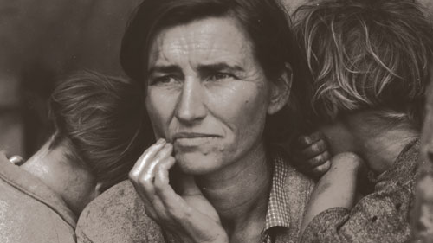
What was the Great Depression?
The Great Depression was a time of economic downturn after the crash of the stock market in 1929 and the banking failure. Prior, Murray Rothard wrote, “It is undeniable that ever since the Fed…our inflations have been more intense, and our depressions far deeper than ever before.” The Fed was already loaning money to banks which resulted in banks taking riskier loans. Between 1929 and 1933, unemployment in the U.S. started from 3.2% to 24.9%. The Great Depression caused a sharp increase in protest and hatred for capitalism. Finding jobs was harder as companies could not sustain workers. The Great Depression was a time where the GDP became incredibly small in a short time.

Slide 3
How did the Great Depression affect life?
The Great Depression rendered many families without a stable income or with small wages. With such little demand for over-inflated goods, the supply was reduced, and jobs were cut. Many families could not afford to feed all their children and had to choose. Widespread poverty and hunger defined the time of low employment and terrible conditions. Approximately one-fourth of Americans were unemployed, the rest battling reduced hours and lowering wages. Children started to work to support their families, finding whatever work they could. Daily life was bleak and was made up of finding work or doing chores at home.

Slide 4
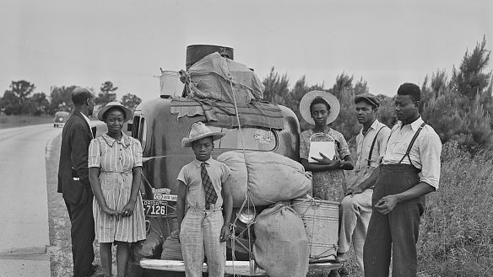
Migrant Workers in 1930’s
Migrant Workers were relocated because of the Dust Bowl since they were dependent of the land which was rendered unworkable. They went to larger, urban areas to look for jobs, usually with no avail. Most became homeless because of their conquest to move West.
In California, migrant workers looked for jobs with little success, as everyone was struggling to find work. Californian workers were discriminatory to Okie or Mexican farmers looking for jobs; some were even turned away from the borders.
The few who did find jobs worked in poor hygiene and sanitation with decreasing wages to feed growing families. The lack of resources turned poor hygiene and sanitation into widespread disease. The toil did not equate to the low wages given the workers. Migrant workers’ camps were characterized by extreme poverty, starvation, and filth.

Slide 5
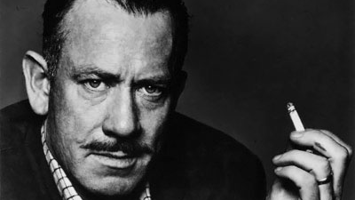
Who was John Steinbeck?
John Steinbeck(1914-1968) established himself as an author by publishing short works, growing famous for his Tortilla Flat (1930), Of Mice and Men(1937), and Grapes of Wrath(1939). He wrote conveying clear morals for his novels, usually portraying poor working-class laborers. He experienced the economic hardship first-hand, living through the Great Depression in California. Of Mice and Men was a tool for raising awareness of the harsh conditions of not only the Great Depression but the lives that were affected by it. Steinbeck worked as a hired hand for farmers where he witnessed the conditions firsthand.

Slide 6
What was the inspiration for Of Mice and Men?
John Steinbeck was inspired by the events of the Great Depression and the poem “To a Mouse” by Robert Burns. John Steinbeck himself came from humble beginnings, working as a migrant laborer. Raising awareness for the disastrous working conditions of economic depressions was the objective of most of the works Steinbeck wrote such as “The Pearl”, Of Mice and Men, and Grapes of Wrath. The characters in the novel were inspired Steinbeck met working.

Slide 7
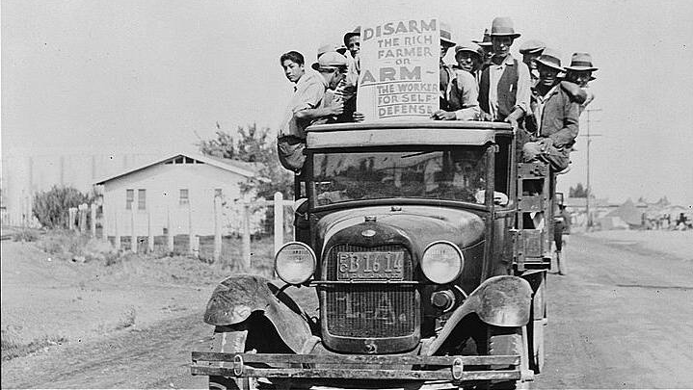
Salinas Valley: Migrant Worker Haven
Salinas Valley, California was a prime hub for immigrant work and the setting for Steinbeck's Of Mice and Men. It became such an agricultural hub that by 1930, the population grew to more than 10,000 residents living there. It became a spot of protest.
The landscape consisted of fertile land and agricultural growth. It was flat and bare with nutrient-filled soil.
The dominant crops were almonds, fruits, and wheat. Orchards, flowering trees, and crops lined the ground and were a sign of agricultural growth and prosperity.

Slide 8

What is the “American Dream”?
The “American Dream” is having the freedom and liberty to live leisurely and support a family. The Great Depression tested this freedom and introduced the Economic Bill of Rights which highlighted certain aspects such as the right to a job, food and a home.
The “American Dream” changed with the Great Depression as unemployment rates increased and food became sparce. The “American Dream” would have more similar to the Economic Bill of Rights. The workers would want the right to have a stable job, home, and the ability to provide for their family. The people in the 1930’s wanted to live under a stable income and higher wages.

Slide 9
“American Drean” in Of Mice and Men
Of Mice and Men exposes us to unimaginable topics such as the harsh conditions of the Great Depression. This short novel encapsulates the ideals of the terrible economic conditions in 1930’s. Of Mice and Men shows the ordeal, strife, and emotional turmoil of the Decade. The characters will have different perspectives on the “American Dream” and their current situation. The people in Of Mice and Men are struggling with economic troubles, as well as their perception of what is happening. They may say they are entitled to a job and produce hate towards the government for the terrible economic conditions.

